Slide 1

Using Machine Learning Network Intrusion Detection in Protecting Patient Health Information.
By Ogbonnaya Steven Okeorji
To use machine learning to detect network intrusions in healthcare systems
2. To train a random forest model that classifies each network connection as normal traffic or an intrusion
3. To show how this tool can help healthcare organizations recognize what makes them susceptible to cyber attacks and avoid them, protecting patient health information
Notes:
Say the project name and the one-sentence use case. Don’t read the three aims word for word.
Give a quick roadmap: problem, data, algorithm, output, limits.
Use the word “proposed.” Don’t say “I built.”

Slide 2
Use Case and Evidence
The problem
Hospital networks are repeatedly targeted by ransomware and other intrusions that put patient health information (PHI) at risk.
Setting and population
U.S. hospitals: the patients whose PHI is stored and moved across the network, and the IT and security staff who protect it.
Why it matters
Munoz Cornejo et al. (2024) analyzed 65 U.S. hospital ransomware incidents from 2016–2022. Patient information was often compromised, including through phishing and server vulnerabilities.
Proposal: I propose using supervised machine learning to classify each network connection as normal or an intrusion, so that hospital security staff can decide which connections to investigate or block before PHI is exposed.
Evidence: Munoz Cornejo et al. (2024); Li et al. (2025)
Notes:
Follow your template: in U.S. hospitals, ransomware and intrusions threaten PHI. This matters because Munoz Cornejo et al. (2024) analyzed 65 incidents from 2016–2022, and PHI was often compromised. So you propose ML to classify connections, so staff can decide what to investigate or block.
Say the author and year out loud for each source.
Say “65 incidents analyzed,” not “65 attacks happened.” They came from 562 reported incidents.

Slide 3
Connection_ID | Protocol | Packet_Count | Failed_Logins | Data_Transferred (KB) | PHI Access | Attack_Type | Intrusion
HC001 | TCP | 47 | 0 | 52 | YES | NORMAL | 0
HC002 | TCP | 61 | 2 | 74 | YES | NORMAL | 0
HC003 | UDP | 20 | 0 | 18 | NO | NORMAL | 0
HC004 | TCP | 640 | 62 | 38 | NO | BRUTE FORCE | 1
HC005 | TCP | 83 | 0 | 96 | YES | NORMAL | 0
HC006 | ICMP | 18,400 | 0 | 1,150 | NO | DoS | 1
HC007 | TCP | 55 | 1 | 64 | YES | NORMAL | 0
HC008 | TCP | 3,900 | 23 | 5,600 | YES | Unauthorized Access | 1
HC009 | UDP | 39 | 0 | 30 | NO | NORMAL | 0
This Data set explains a network activity/connection within a healthcare organization.
With a few failed login attempts, which can occur from a typo, a certain number can prove a malicious attempt to entering a network unauthorized.
Unit of analysis
One network connection (one row)
Inputs
Protocol, packets, failed logins, data transferred, PHI access
Target label
Intrusion (0 = normal, 1 = intrusion). Attack_Type is not an input.
Data status
Proposed example data, not real hospital traffic
Notes:
State three things: the unit of analysis is one connection, the label is Intrusion (0 or 1), and the data are proposed examples, not real hospital traffic.
Don’t read the table. Contrast three rows instead: HC001 (normal), HC004 (62 failed logins) and HC008 (23 failed logins, PHI accessed, 5,600 KB).
Use your callout: HC002’s 2 failed logins look like a typo, while 23 or 62 do not.
Mention that Attack_Type explains the label but is not an input, because it would give away the answer.

Slide 4
Machine Learning Type and Task
Learning type
Supervised
Every example already has a known answer (the Intrusion label), so the model learns from labeled data.
Subtype and task
Binary classification
For each new network connection, predict one of two classes: Normal (0) or Intrusion (1).
Algorithm
Random forest
Many decision trees each vote, and the majority vote becomes the final prediction.
Why not unsupervised?
Unsupervised learning looks for patterns without labels. This data already has labels, so it is not needed here.
Notes:
Give the chain in one breath: supervised, then binary classification, then random forest.
Give one sentence on why not unsupervised: Unsupervised learning looks for patterns without labels. This data already has labels, so it is not needed here
The goal of this machine supervised learning is to correct labels let the team act before PHI is exposed.

Slide 5
Why Random Forest?
Fit to the task and data
Built for classification: the trees vote to label each connection Normal or Intrusion.
Handles the mix of inputs in the data: protocol type, counts, and yes/no fields.
Can rank which inputs mattered most (for example, failed logins), which helps analysts trust a flag.
Journal evidence: Li et al. (2025) combined random forest with semi-supervised learning and reported accuracy gains of 8.92% (NSL-KDD) and 6.1% (UNSW-NB15).
Tradeoffs and limitations
Journal evidence: Li et al. (2025) note intrusion detection systems still struggle with false positives, false negatives, new attacks, and scale.
A random forest learns from past labeled examples, so new attack types may slip through until it is retrained.
A forest of many trees is harder to explain than a single decision tree.
Notes:
Fit: it is built for classification, it handles mixed inputs, and it can rank which inputs mattered.
Evidence: Li et al. (2025) reported accuracy gains of 8.92% (NSL-KDD): an improved, cleaned-up benchmark dataset used to train and test Network Intrusion Detection Systems (NIDS) using machine learning
and 6.1% (UNSW-NB15): a standard benchmark dataset used to train and test Network Intrusion Detection Systems (NIDS) and machine learning models for cybersecurity.
Say it was random forest combined with semi-supervised learning, not random forest alone.
Tradeoff: a false negative lets an intrusion through, and a false positive wastes analyst time. New attack types can also slip through until the model is retrained.
The tradeoff that matters most: a false negative lets a real intrusion through; a false positive wastes analyst time.

Slide 6
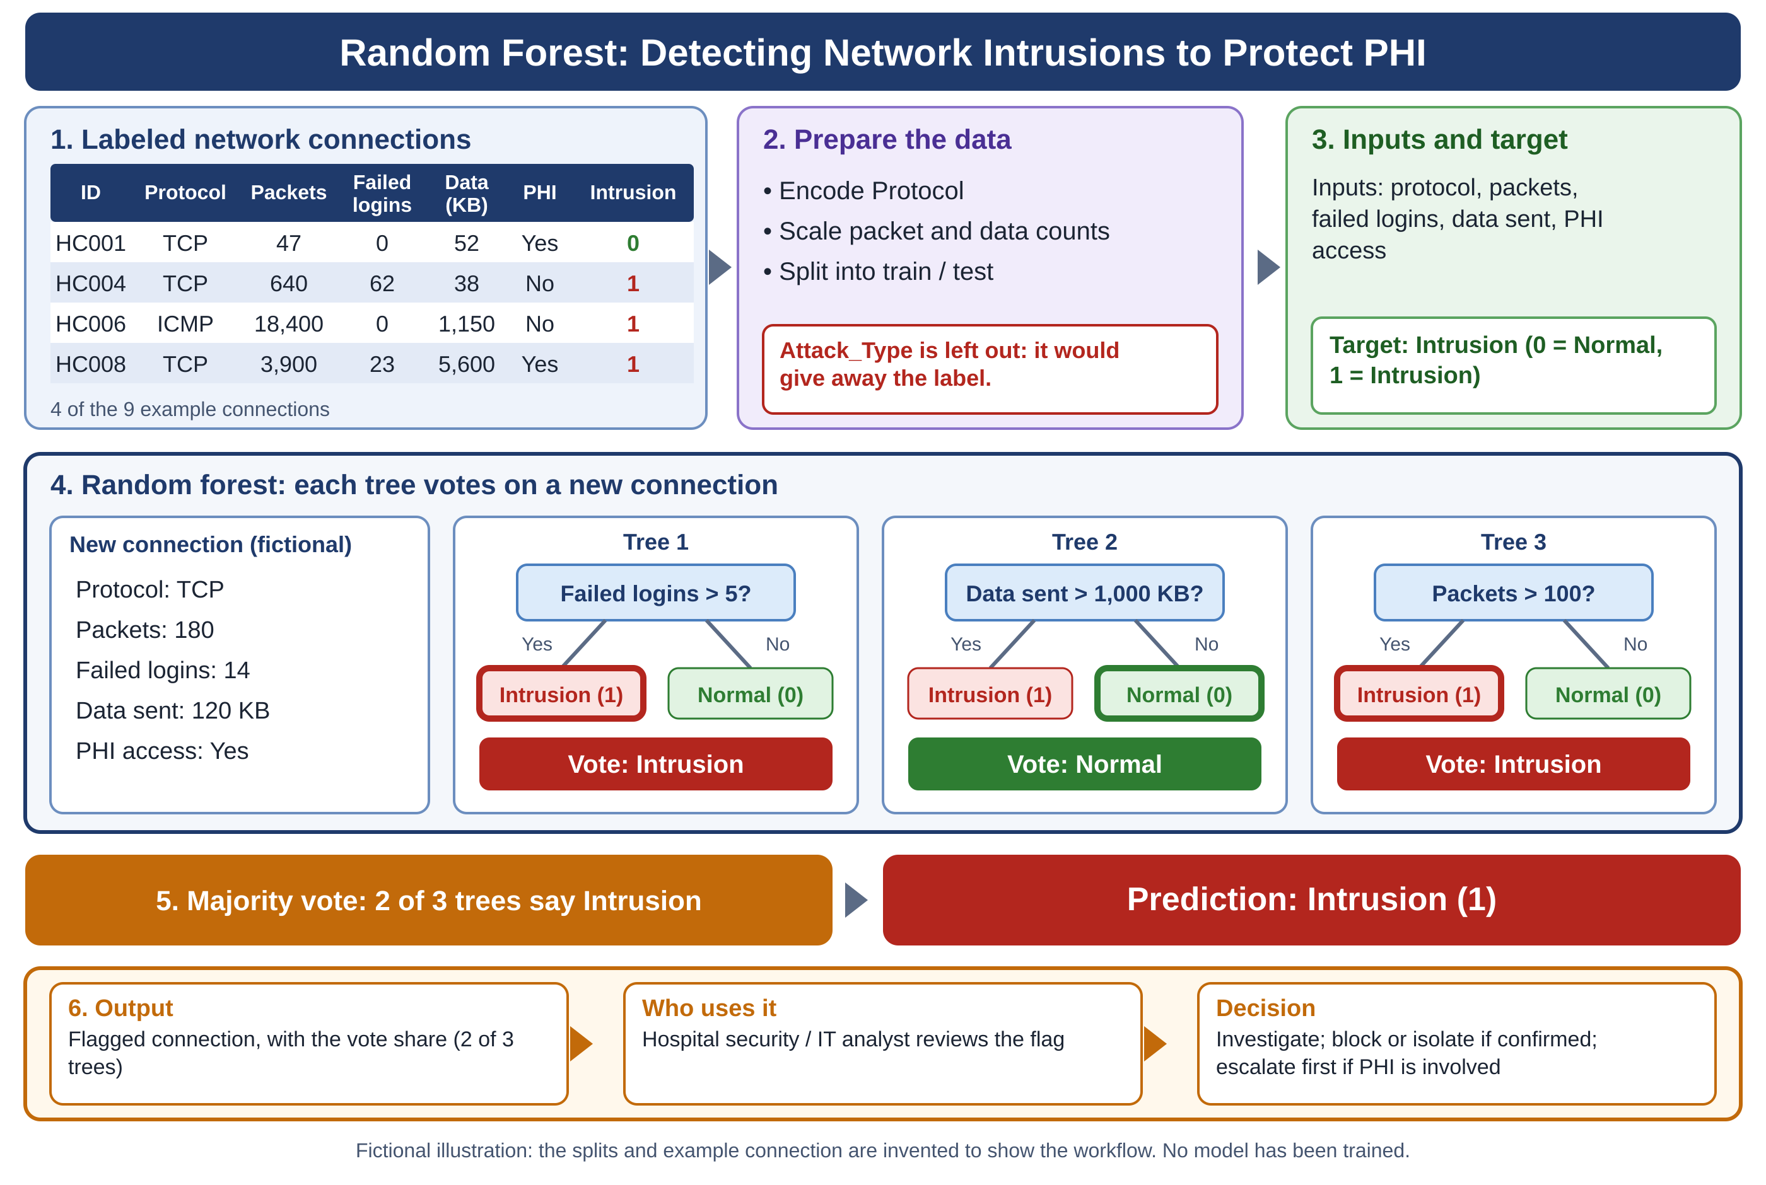
Fictional illustration made with ChatGPT, not a real result. The model learns from labeled connections, then predicts Normal (0) or Intrusion (1).
Goal: flag each intrusion so the security team can stop a breach before patient data is exposed. In the real model, Attack_Type would not be an input because it gives away the label.
Input-to-output workflow
1. A connection’s features go in (protocol, packets, failed logins, data, PHI access).
2. Each decision tree votes Normal or Intrusion.
3. The majority vote is the final prediction.
4. Intrusions are flagged for the security team.
Notes:
Walk it in order: labeled data, prepare, trees vote, majority vote, decision.
Follow the one example. The new connection has 14 failed logins and 180 packets. Two trees vote Intrusion and one votes Normal, so the prediction is Intrusion. The disagreement shows why voting helps.
Say it is fictional and that no model has been trained.
Don’t explain every box.
The callout still says “made with ChatGPT.” That is fine if you want to disclose AI help, but I redrew the diagram separately, so make sure it matches how you describe it.

Slide 7
Output and Decision
Model output
For each network connection: a prediction of Normal (0) or Intrusion (1), plus the share of trees that voted Intrusion as a confidence signal.
Who uses it
Hospital security and IT analysts, who review flagged connections as the network logs them.
Decision that follows
Investigate the flagged connection, block or isolate it if confirmed, and escalate first when it involves PHI.
Why it matters
Acting early limits how much patient information is exposed. Munoz Cornejo et al. (2024) show hospital incidents often compromise PHI.
Proposed design: the model supports the analyst’s decision; it does not replace it.
Notes:
Output: Normal or Intrusion, plus the share of trees voting Intrusion.
User and timing: security and IT analysts, reviewing flagged connections as they are logged.
Decision: investigate, block or isolate if confirmed, and escalate first if PHI is involved.
Why it matters: acting early limits exposure. End on “the model supports the analyst, it doesn’t replace them.”

Slide 8
Limits and Next Steps
Completed so far
Defined the use case and kept the scope small: one hospital network, binary classification.
Built an example dataset of 9 connections with an Intrusion label.
Mocked up the random forest workflow (slide 6).
Still unfinished
The model is not trained or tested, so there are no accuracy results yet.
No real (de-identified or public) network data has been collected.
Alert thresholds and the analyst review workflow are not defined.
One check before real use
Train on part of a labeled dataset, then test on connections the model has not seen. Report false negatives and false positives, not just overall accuracy.
Limits from the literature
Munoz Cornejo et al. (2024): based on breaches reported to OCR; 65 of 562 reported incidents met the study’s criteria, so the picture is limited.
Li et al. (2025): false positives, false negatives, and adapting to new attacks remain open challenges.
Notes:
Be direct about status. Done: use case, example dataset, mockup. Not done: model not trained or tested, no real data.
Give the one check: train on part of a labeled dataset, test on unseen connections, and report false negatives and false positives, not just accuracy.
Give literature limits briefly: Munoz Cornejo’s data came from reported breaches, and Li et al. flag false positives and adapting to new attacks.
Present this as a plan, not an apology.

Slide 9
References
Munoz Cornejo, G., Lee, J., & Russell, B. A. (2024). A thematic analysis of ransomware incidents among United States Hospitals, 2016–2022. Health and Technology, 14(6), 1059–1070. https://doi.org/10.1007/s12553-024-00890-3
Li, J., Sun, H., Du, H., Li, L., & Zhang, Z. (2025). Network intrusion detection method based on semi-supervised learning and Random Forest. IEICE Transactions on Communications, E108-B(10), 1152–1163. https://doi.org/10.23919/transcom.2024ebp3204
In closing: this project proposes a supervised random forest that flags network intrusions in hospital networks, so security staff can act early to protect patient health information.
Notes:
I believe that using supervised machine learning (random forest) to classify each network connection as normal or an intrusion would be a great way to protect PHI, on slide 6 we have seen the breakdown as to what is allowed/accepted. Despite the limitations, I believe that in due time, especially the steps that technology in healthcare is going, there would be improved machine learning to improve network security for the healthcare industry.

